Slide 1
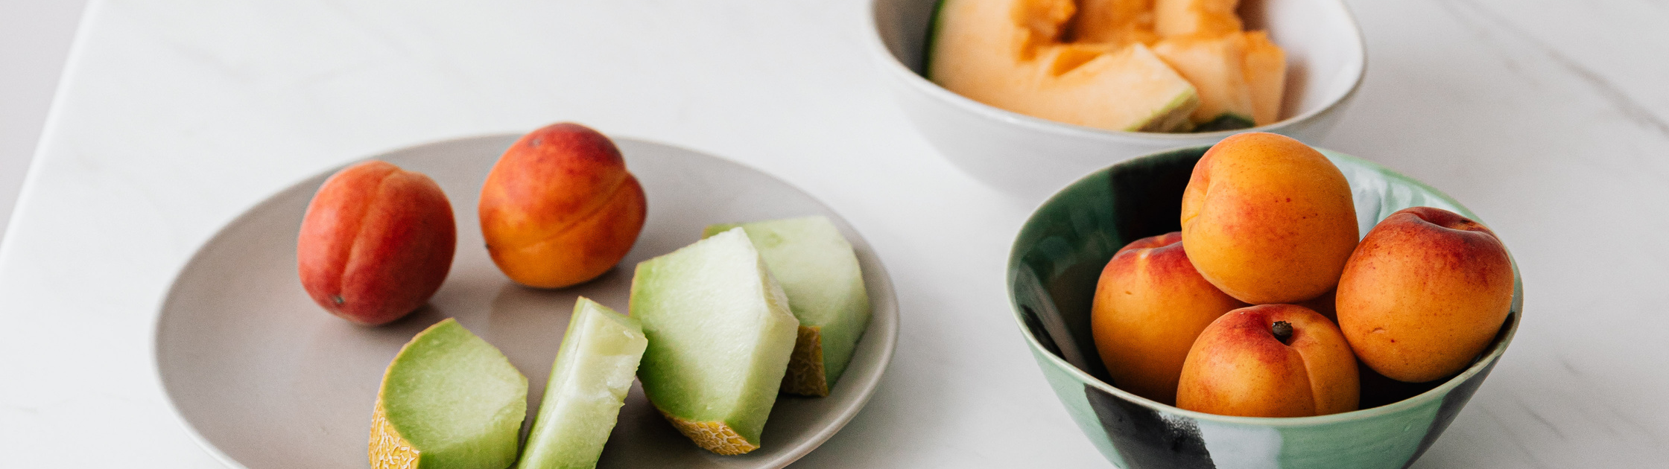
Project 1
UK Food Trends
Helen, Kassem & Rahmi

Slide 2

Introduction
Our presentation will look at the UK Food trends since the turn of the millennium.
We've used data from the UK government website (DEFRA) on food and farming.
Our aim was to identify food and drink trends as well as finding the underlying information from the data. To draw our food & drink consumption popularity.

Slide 3
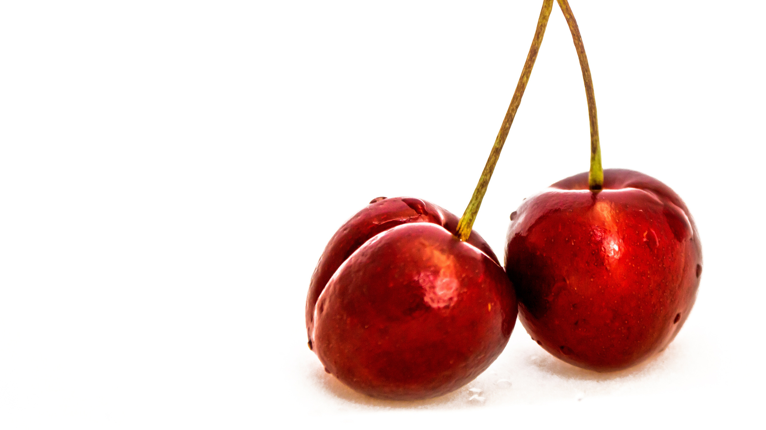
Methodology

Slide 4
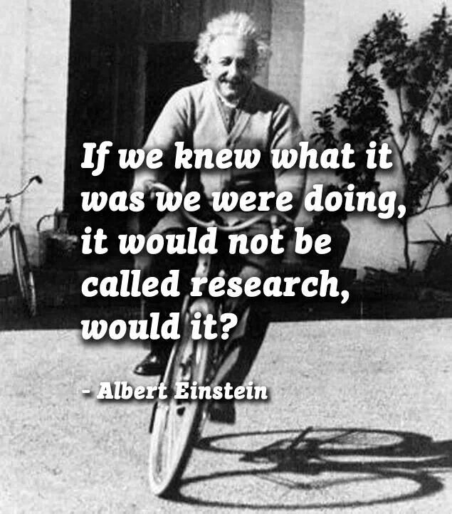

Research is formalized curiosity. It is poking and prying with a purpose
— Zorah Neal Hurtson

Slide 5
Our Methodology
We found data from UK Gov websites for Farming and food containing various information related to our area. we narrowed down to look at food trends since the turn of the millennium looking at popularity of food and drink by uk household at various age groups.
After going through all the choices between API's and Datasets we picked the UK household family food datasets. This contained detailed information on UK household purchases include statistics.
Initial data exploration was done to better understand and visually identify anomalies within the data as well as focus our research to which area's we wished to explore. When this process concluded we decided on our data set's but instead of picking one data set we have pooled various data sets together to which we created our data frame rather than take an already construct and available one.
The we split the questions amongst the group and produced the relevant code to give us answers to our questions.

Slide 6


The Dataset
a little background on our data set ......
11 Food Categories
23 Food Groups
169 Major Food Categories
134 Minor Food Categories
40 Columns 338 Rows 7700 cell in total

Slide 7



Slide 8
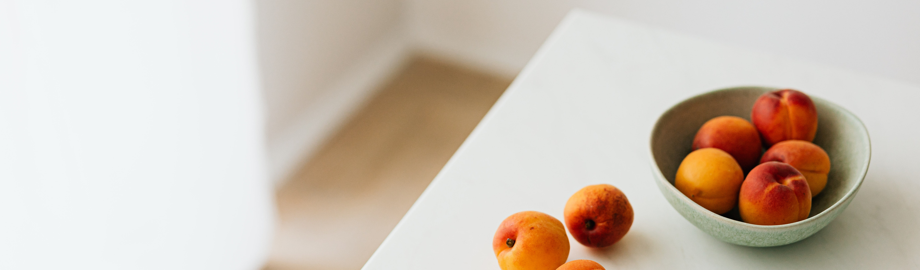
The Data & Our Findings

Slide 9
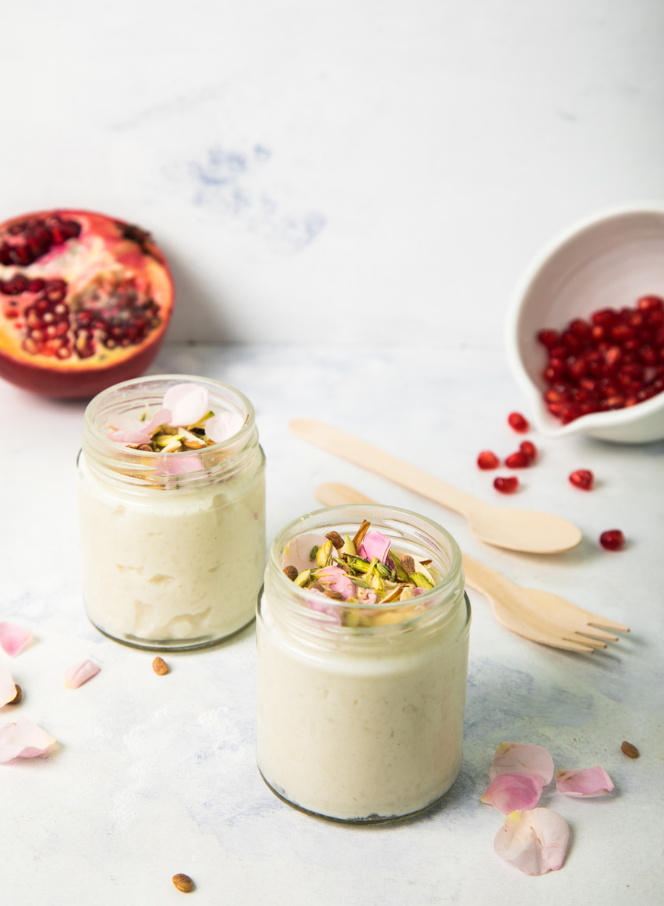
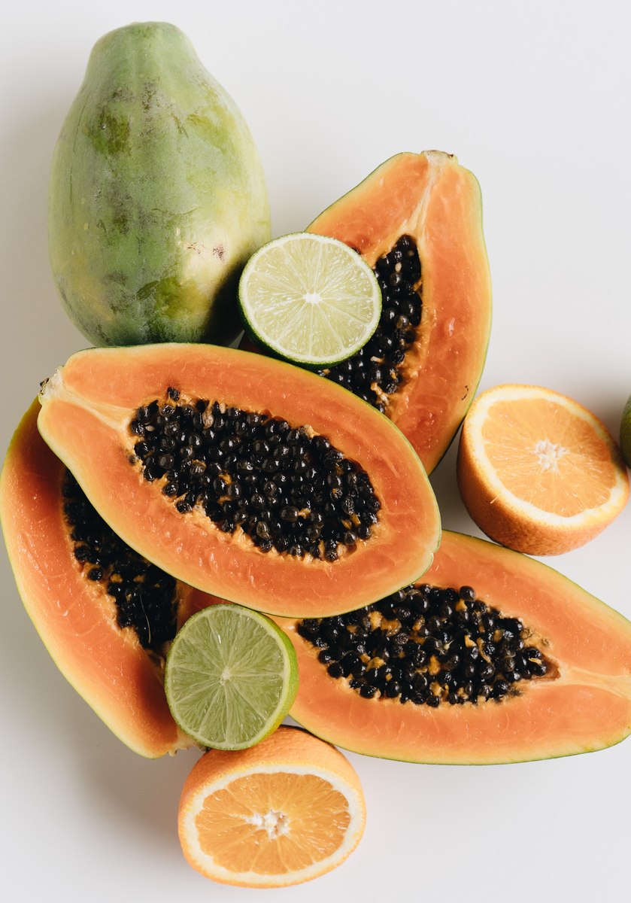
Findings - 1st Phase Food Groups
FOOD & SNACKS
DRINK
What is the most popular by all age Group.
underlying trend by age group
What is the most popular by all age Group.
underlying trend by age group

Slide 10
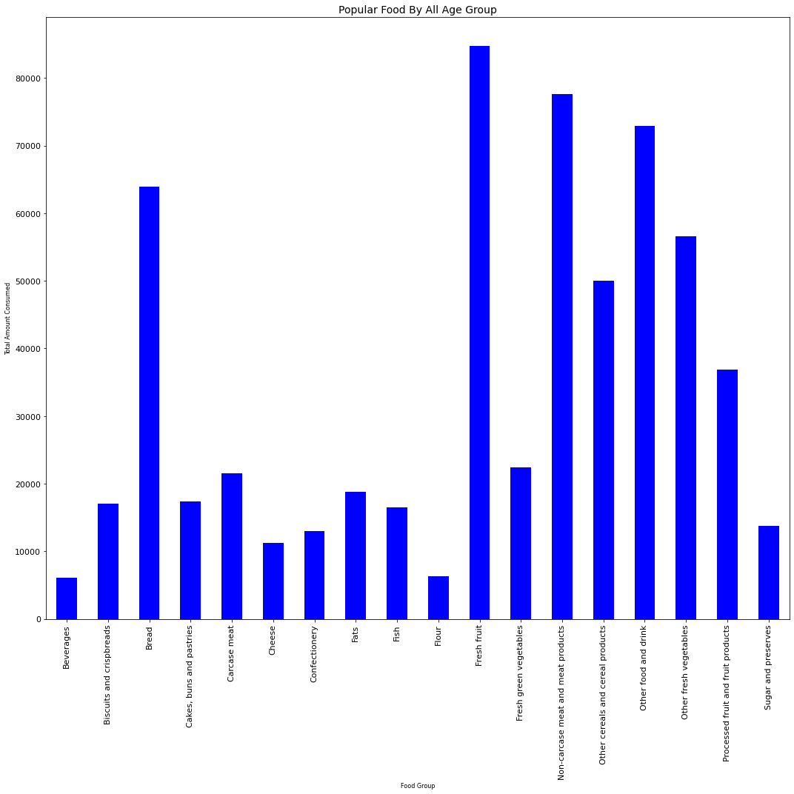

01
MOST POPULAR FOOD?
Bread, Fruit, Non Carcasses Meat & Other Food & Drink Category
02
WHAT ARE OTHER FOOD?
Mineral Water, Baby Food, Soups, Sauces, Salt & Ice Cream.
03
WHAT IS NON CARCASSED MEAT?
Liver, Bacon, Ham, poultry not in cans, Sausages
04
FRESH FRUIT
Oranges, Apples, Pears, Grapes & Bananas.
05
SPECIAL MENTION
Beverages, unit of measure & Contents (Tea, Coffee, Instant Coffee Malt Drinks, Cocoa Drinks & Takeaway Drinks.

Slide 11
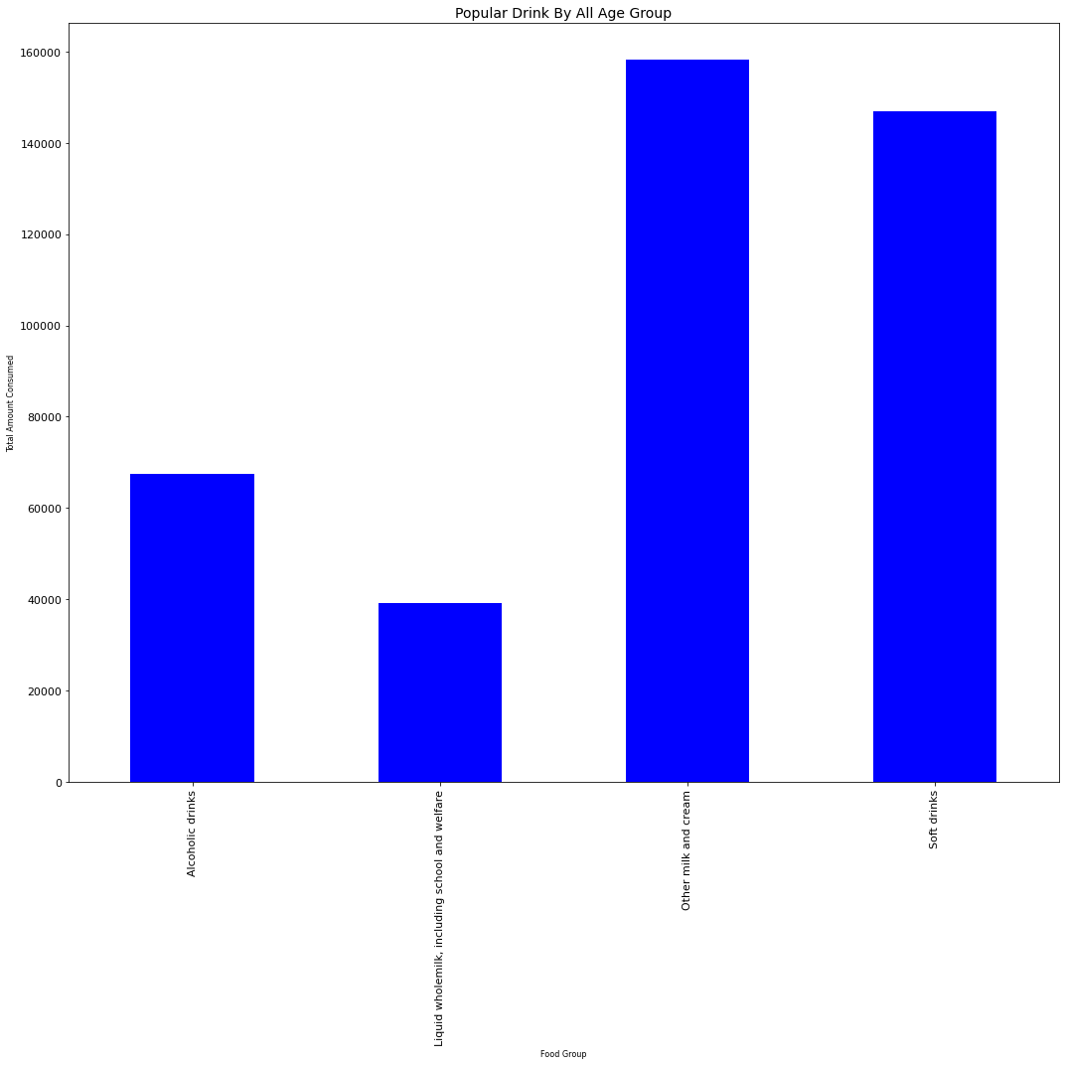
01
WHAT IS THE MOST POPULAR DRINK?
Skimmed milk (semi/ full), yogurts & other dairy deserts, Non-Dairy Milk substitutes
02
LIQUID WHOLEMILK
vs. Skimmed Milk (Part / Whole)
03
SOFT DRINK
Soft Drink 2 categories - low cal and non low cal. (April 2018)
04
ALCHOHOLIC DRINKS
Give us hope we are not a nation of alcoholics at the time of this survey data.

Slide 12
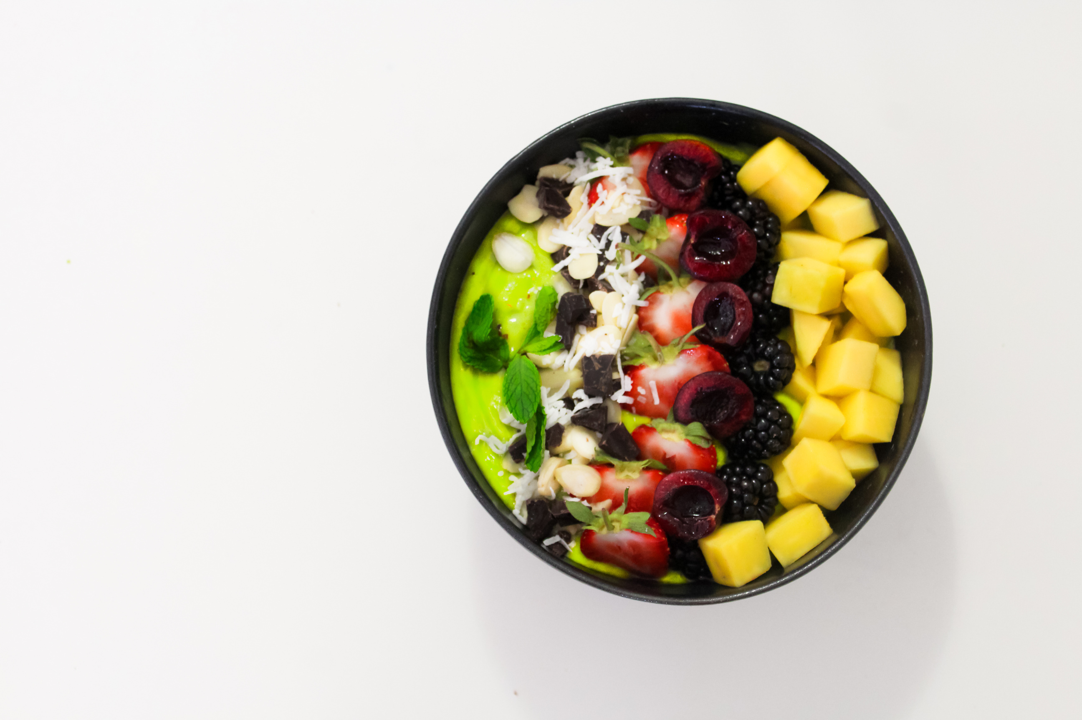

Phase 2 - Deep Dive

Slide 13
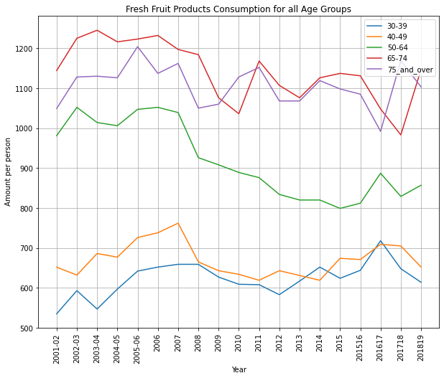

What does the data tell us.....
decline in consumption across 4/5 categories starting in 2007 and continuing till 2010.
2015 for 50-64

Slide 14


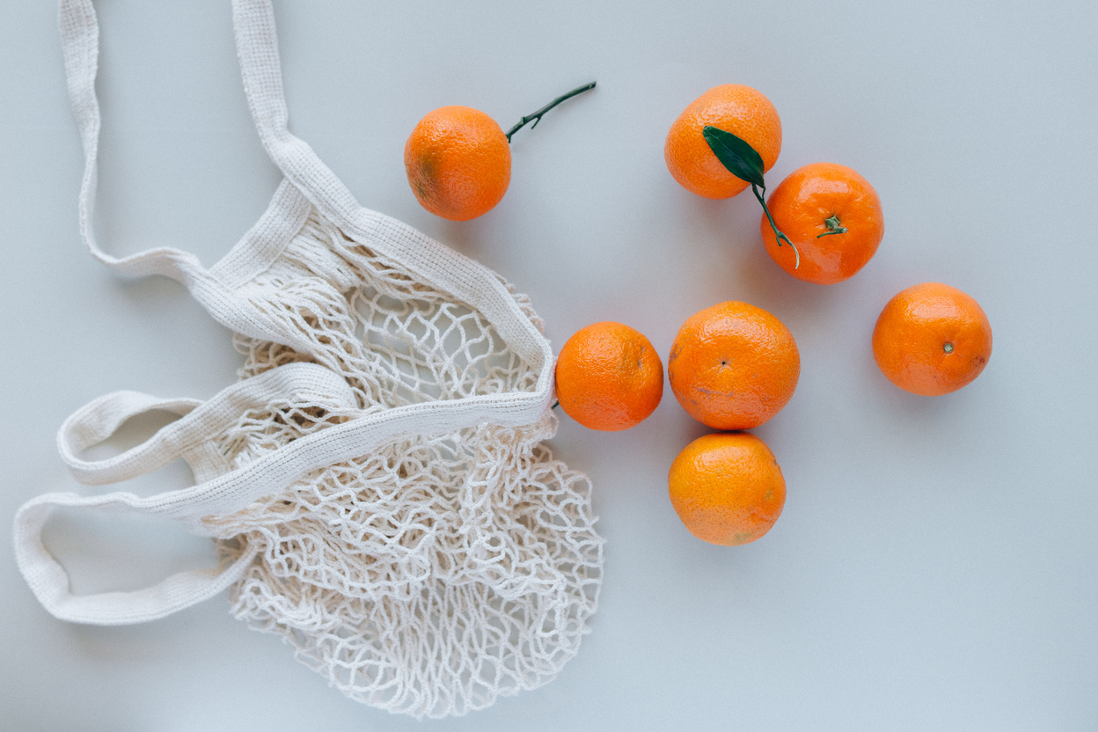
Fresh Fruit
30-39 & 40-49
65-74 & 75+
50-64
have similar attitude on average to fruit consumption as they are close to each other consumption level. (600-700g per week)
Are the highest consumer of fruit. (Health Benefits?/ overlay info with health data in future studies?)
from 2007 had a steady decline in fruit consumption till 2015, does the economy influence this demographic more than others? or did the recession change habits

Slide 15
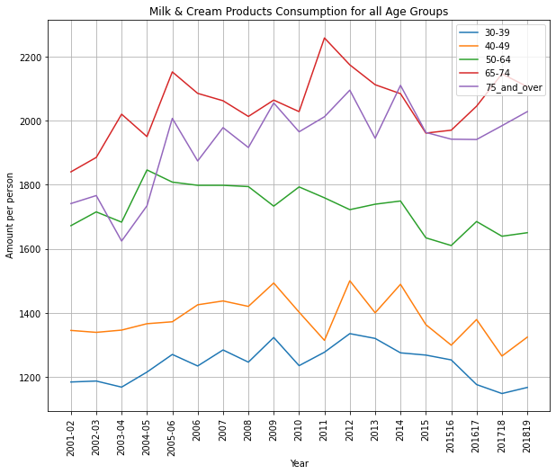
Let talk about Drink.........
Focusing on our most popular category….Ranking of the age groups.

Slide 16
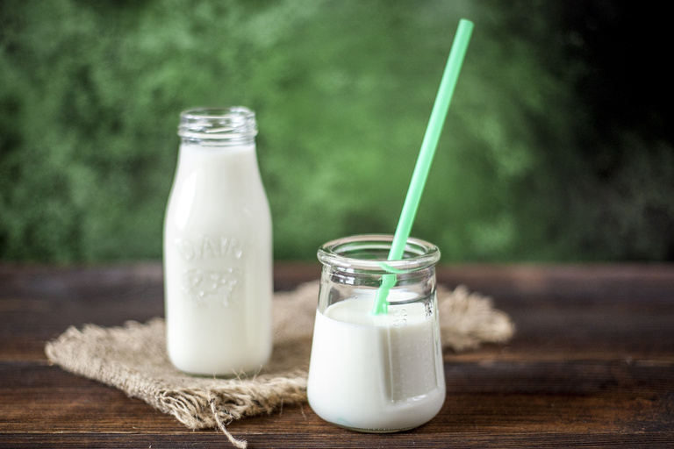
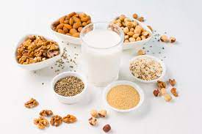
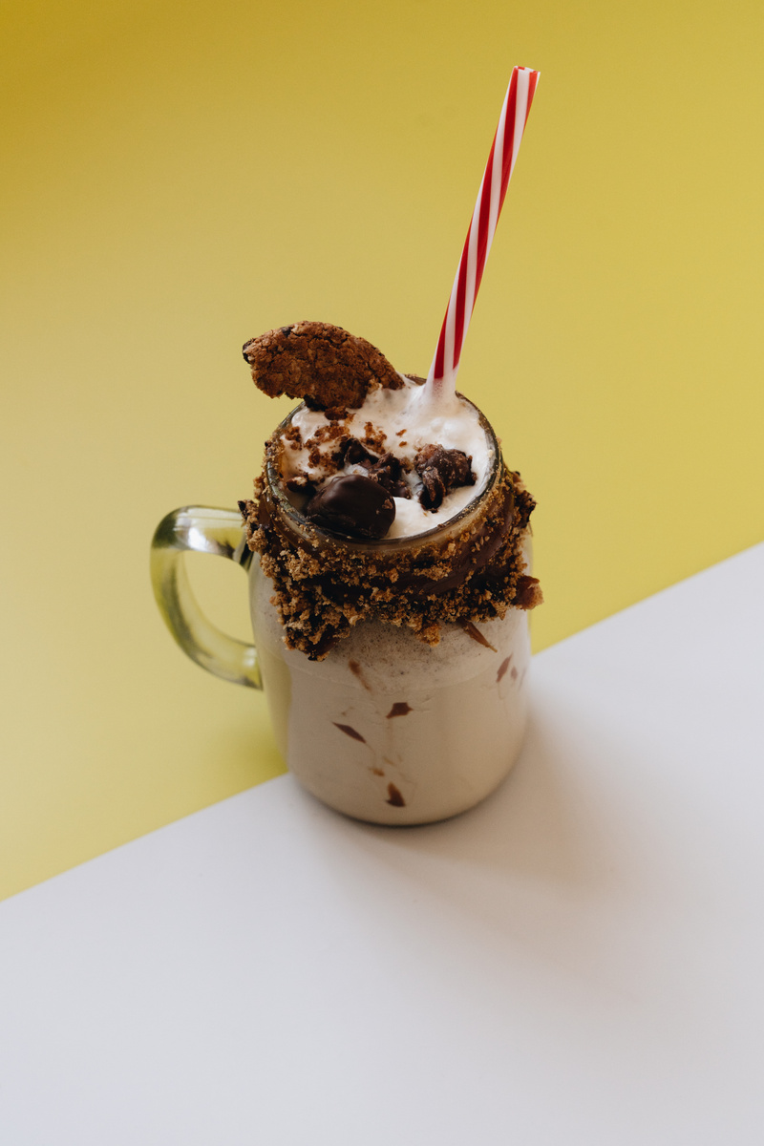

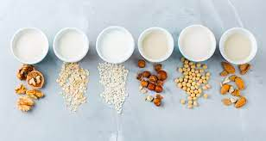
Milk & Cream Drinks
ALL AGE GROUPS
65-74 & 75+
50-64
the graph also tells us unlike fruit the economic condition don't have the same level of influence in consumption habits.
Upward Trend in milk consumption, peaking at 2.2 liters per week in 2011.
3rd highest consumer of milk staying stable in that position between 1.6-1.8 liters per week.

Slide 17
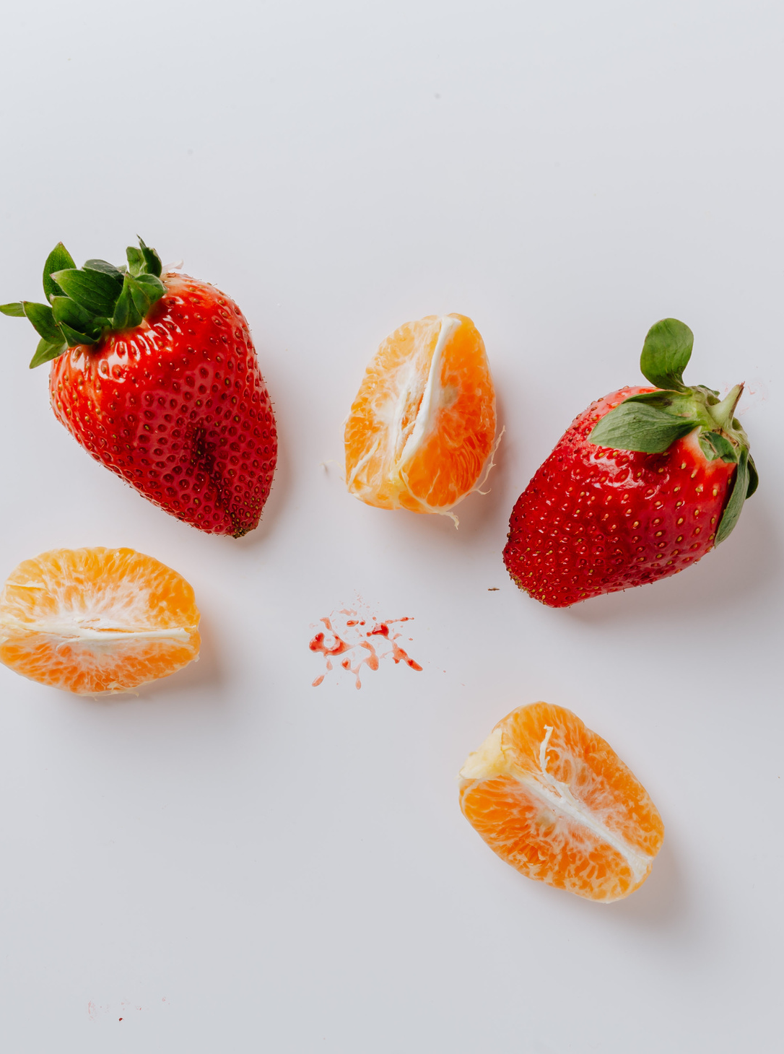
Rahmi - Level 2

Slide 18
Level 2
Minor food code – any surprises?

Slide 19
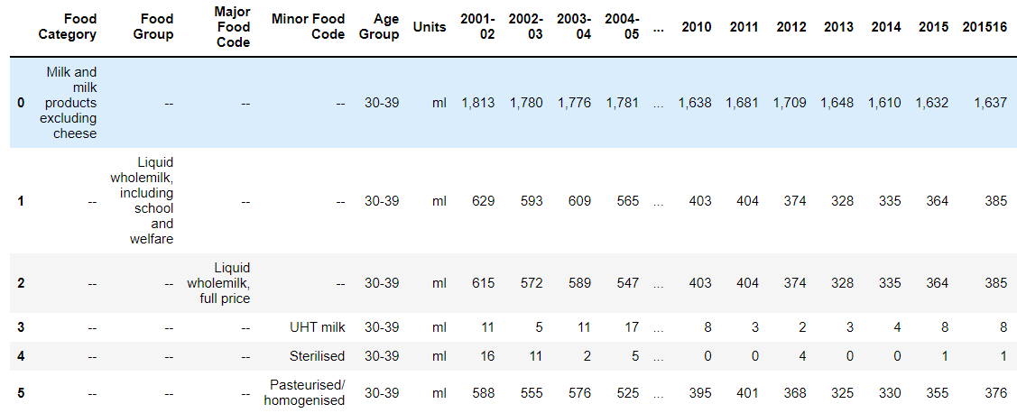
Category choice

Slide 20
01
30-39
02
40-49
5 Age groups
03
50-64
04
65-74
05
75 and over

Slide 21

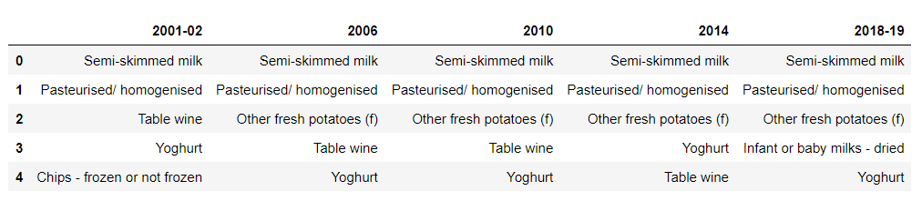
Age Group 30-39
Baby milks popularity in 2018-19, one-off or trend?

Slide 22
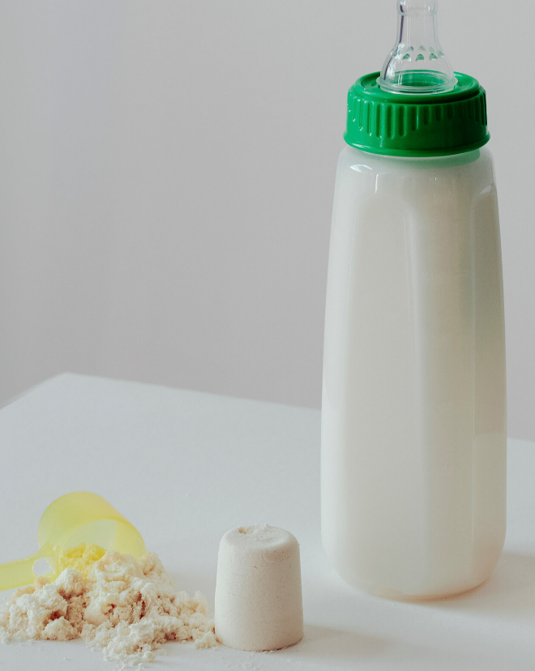
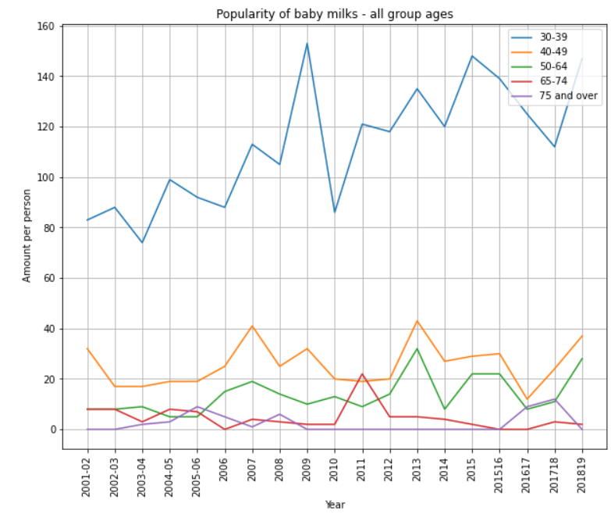
The popularity of baby milks
Increased from 83 to 147 ml per person in the period 2001 – 2019
A huge 77% jump

Slide 23
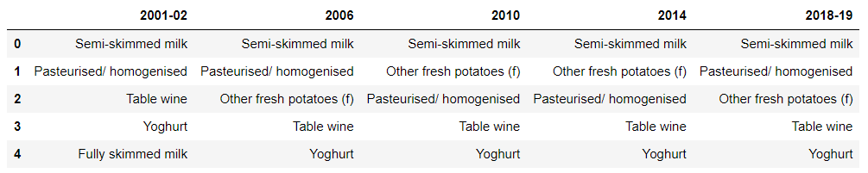
Age Group 40-49

Slide 24

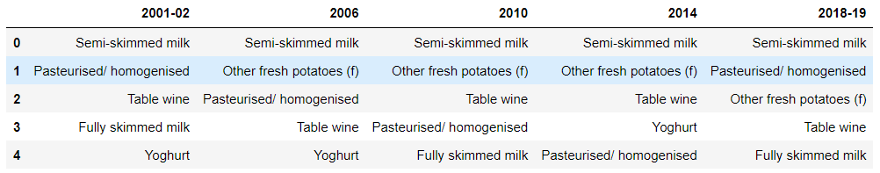
Age Group 50-64

Slide 25

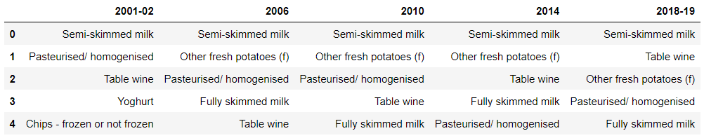
Age Group 65-74

Slide 26

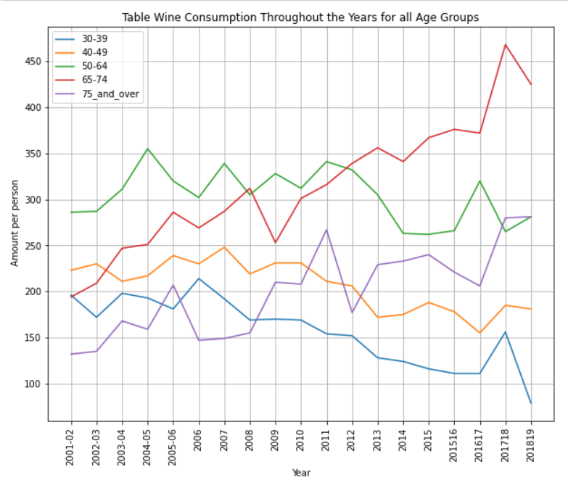
65-74: +119%
75 and over: +112%

Slide 27

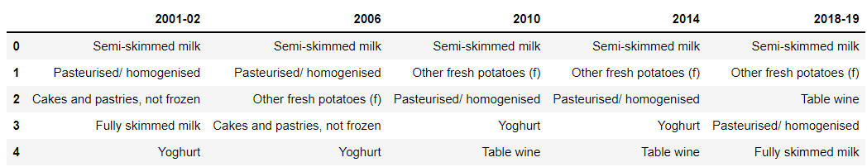
Age group 75 and over

Slide 28
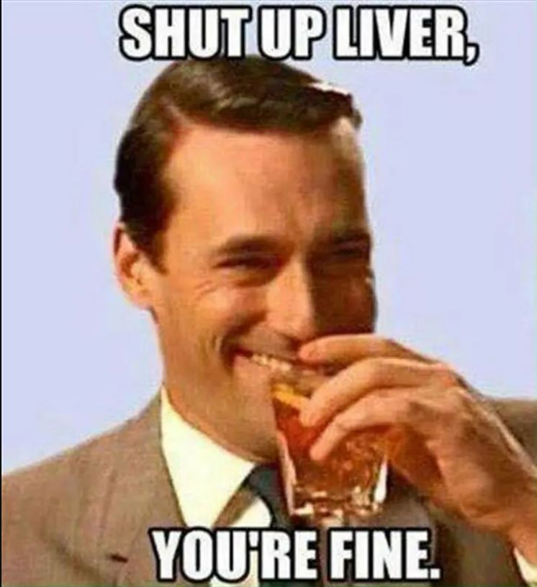

Slide 29
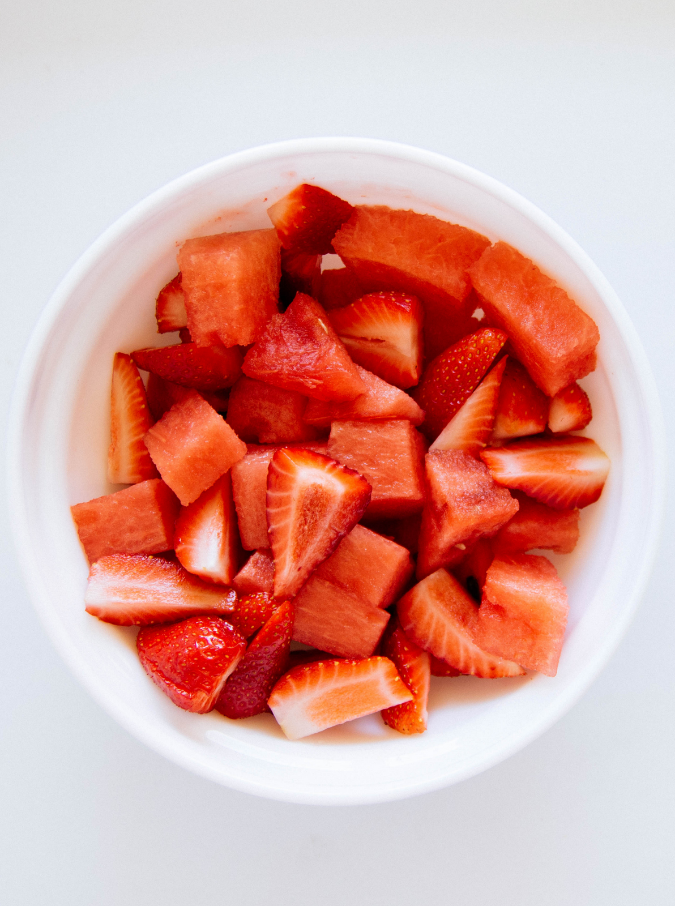
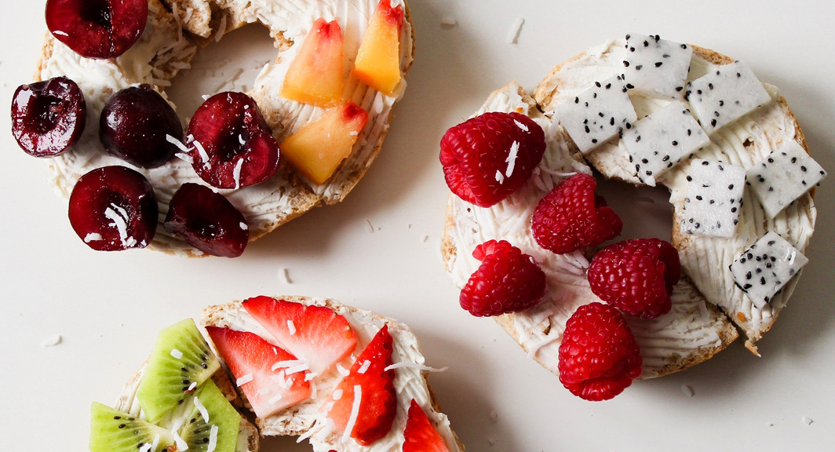
Helen - Level 3
Looking into Individual Food Trends by Type and Age

Slide 30
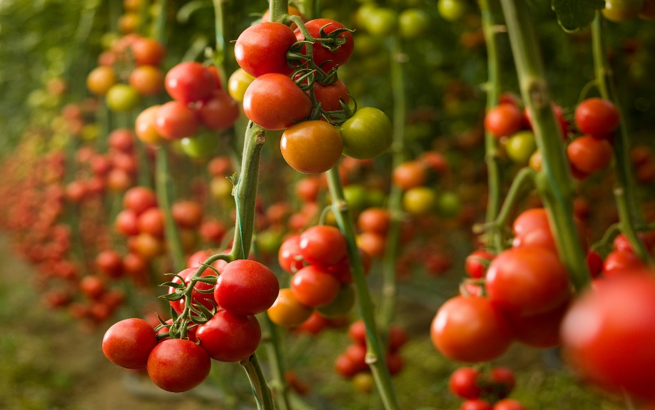
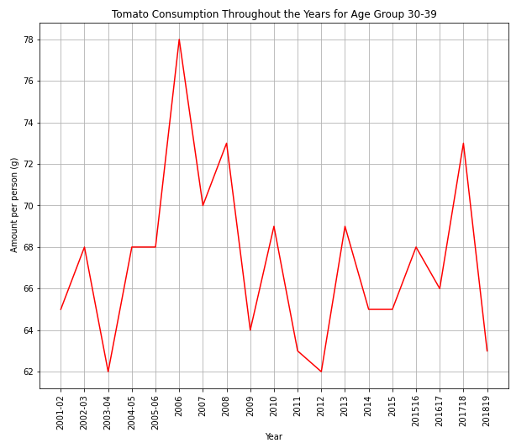
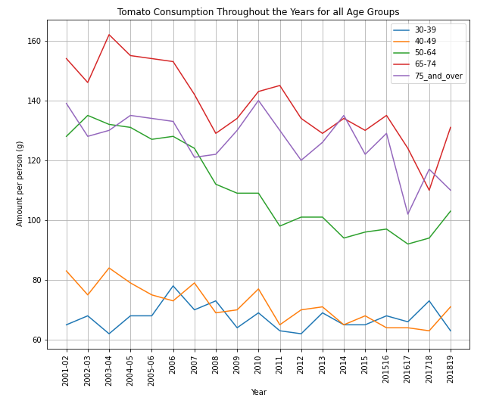
Let’s Talk Tomatoes
Here we are looking at a popular UK ‘vegetable’, we can see the trends appearing between age groups from 2001 and 2019

Slide 31
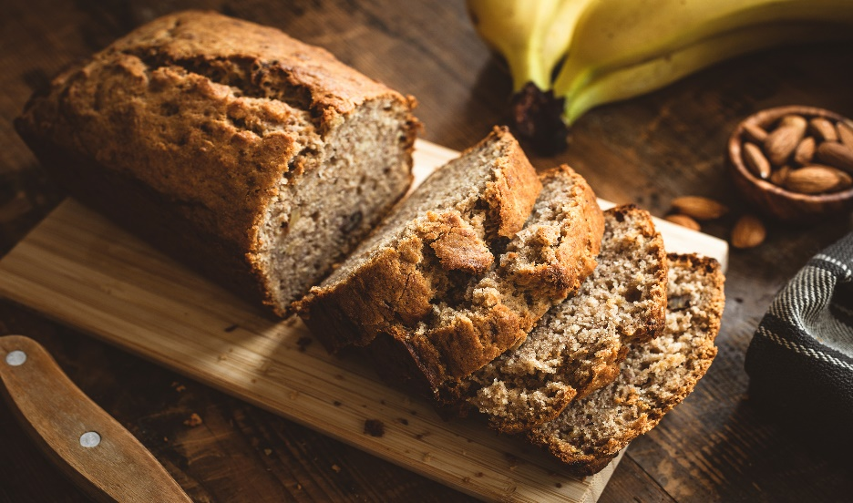
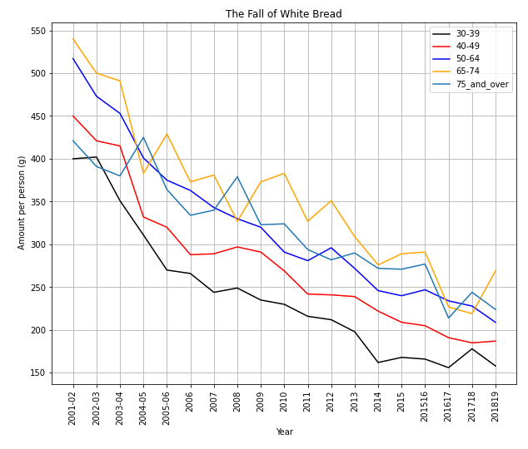
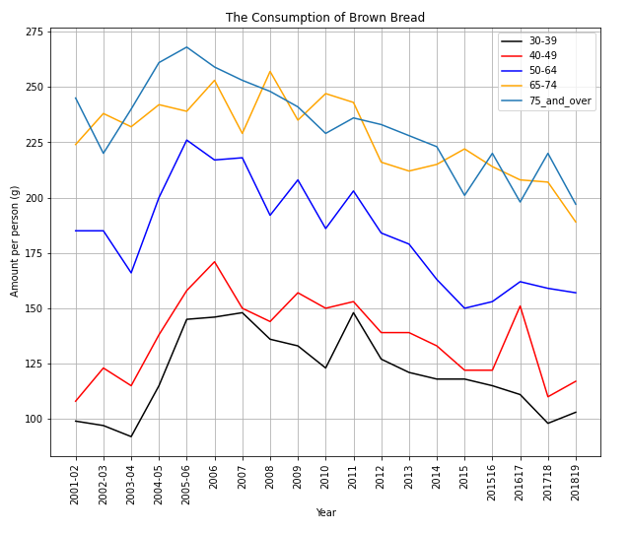
Let’s Talk about Bread
Notice the downward trend for the consumption of White bread from 2001 until 2019 for all age groups.
Brown Bread has a less dramatic increase, but is decreasing nonetheless decreasing, indicating an overall bread consumption decrease.

Slide 32
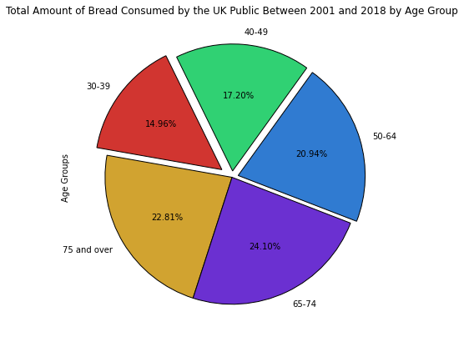

Where’s all the Bread going?
It would appear that as you age, you eat more bread!
This represents all bread products consumed within the UK, under the two categories White Bread and Brown Bread, according to DEFRA, all bread types can be sorted into these two categories.
Age Groups 65-74 and 75 and Over have eaten nearly 47% of all the bread consumed within the UK from 2001 and 2019.
That’s a lot of bread!

Slide 33

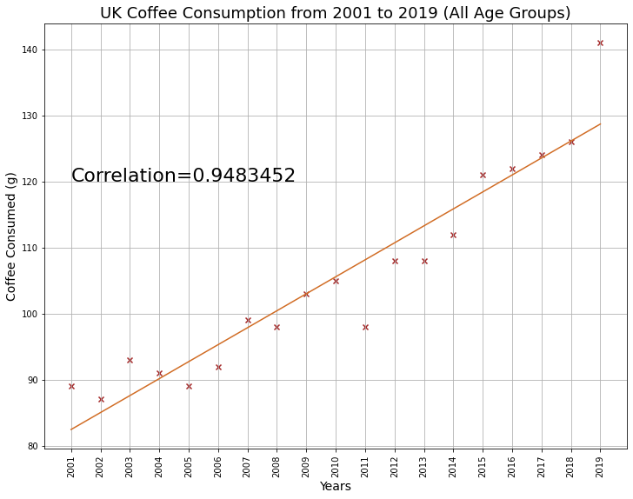
The Coffee Problem
That’s a near perfect correlation!
As years go on the UK coffee needs are increasing at a steady rate.
Does the UK have a coffee problem?
(The answer is yes)

Slide 34
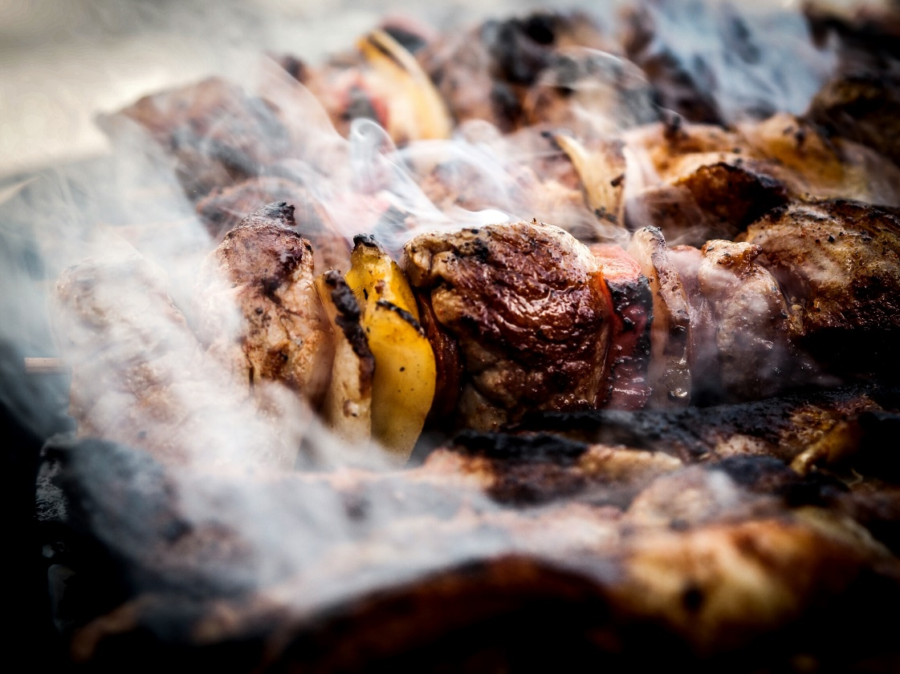
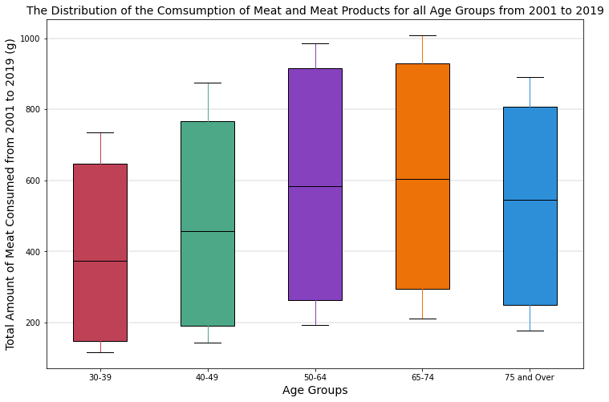
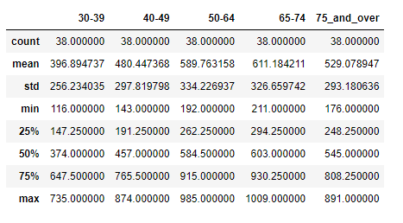
How about Meat?
This graph represents the total amount consumed per age group, as you can see we see a slight upwards trend with age, until you reach 75 and over, in which we notice a decline.

Slide 35

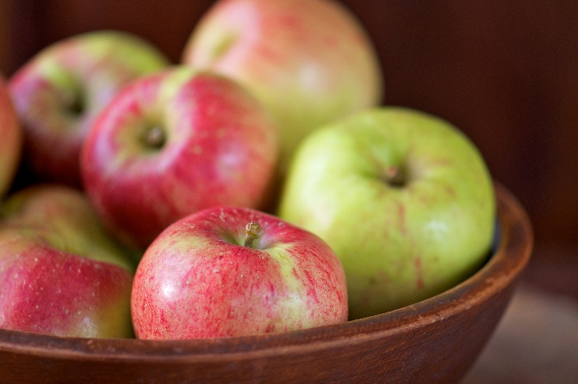



Conclusion
We set out to identify food trends in the UK since the turn of the millennia. With the current cost of living crisis, we thought it a poignant time to look into this information to see how our nation’s eating habits have already changed.
3. Bread, a staple of most people’s standard diet is decreasing, across all ages! Is this the fall of bread?
1. What we have found, as a general rule of thumb, is that fresh produce consumption falls during recessions.
4. The UK has a coffee addiction and it seems to be getting worse.
2. We also found that baby milk usage is on the rise. We are not sure if this is down to environmental factors, nor are we sure if this will continue to climb given the cost of living crisis.
5. Age Group 65-74 drink the most wine and eat the most meat. This really surprised us, it seems this takes a steep downturn at 75 and over.

Slide 36

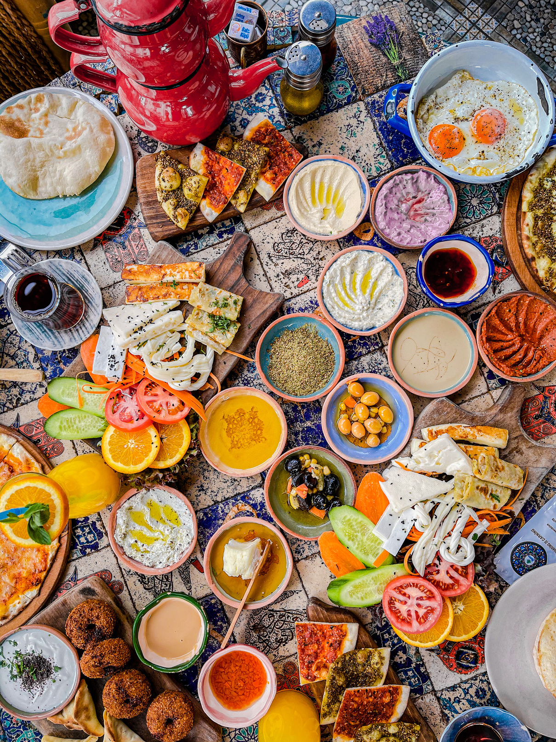
Thank You
Helen, Kassem & Rahmi

Slide 37
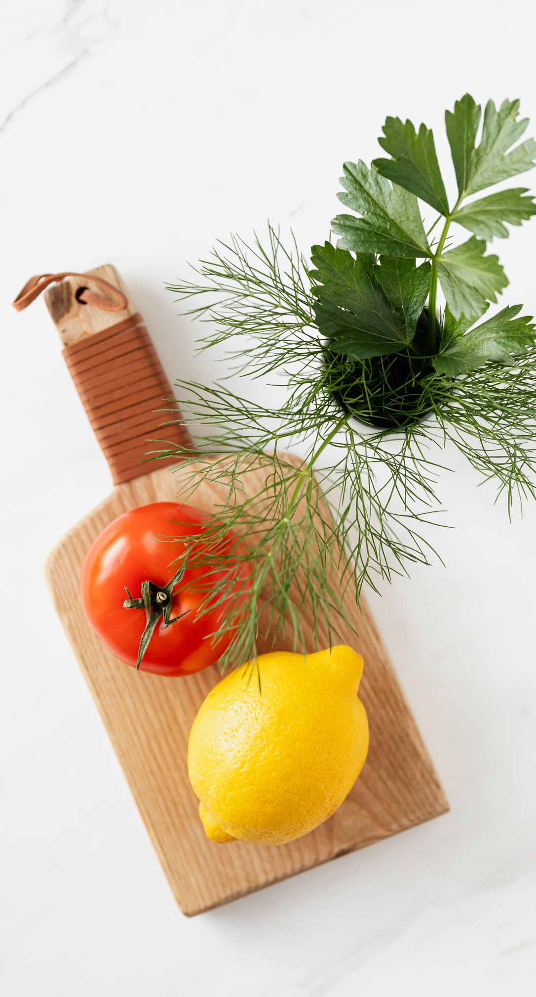
THE FUTURE BELONGS TO THOSE WHO BELIEVE IN THE BEAUTY OF THEIR DREAMS.
— Eleanor Roosevelt

